Slide 1

Crc cards
By – kanaga Manikandan solaikannan

Slide 2
What are crc cards?
CRC stands for Class, Responsibility, Collaborator.
Gathers simple idea about classes’ functionality (Ambler n.d.).
Talking about how they were used.

Slide 3

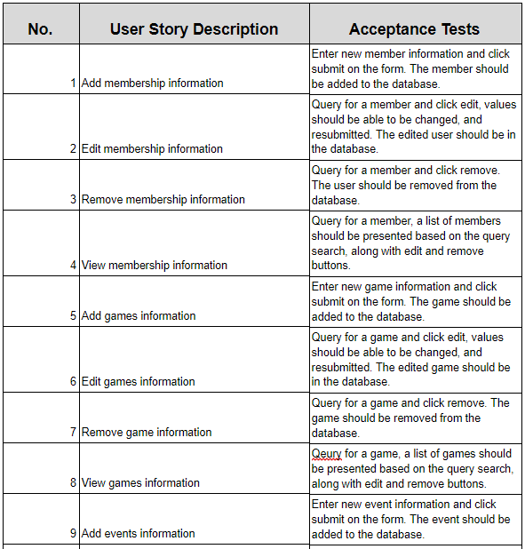
How was it created?
Derived from user stories.
An outline was drawn.
All that was left was to materialise it.

Slide 4
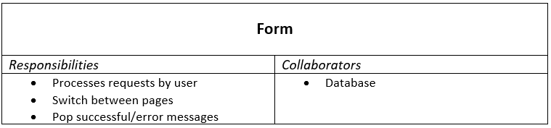
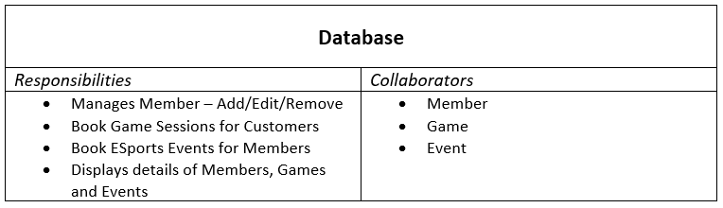
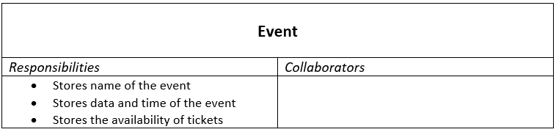
How did it assign responsibilities?
A couple of classes were formed based on the basic outline.
Responsibilities were assigned based on their functions.
Form Class - Responsible for processing user commands and pop up messages.
Database Class - Responsible for managing member details and making bookings.
Notes:
3rd point – It will also be responsible for switching between pages.
4rd point – and making game bookings for customers/members and book events for only members
The other 3 classes hold respective information that will be needed to view whenever the user decides to do so.

Slide 5
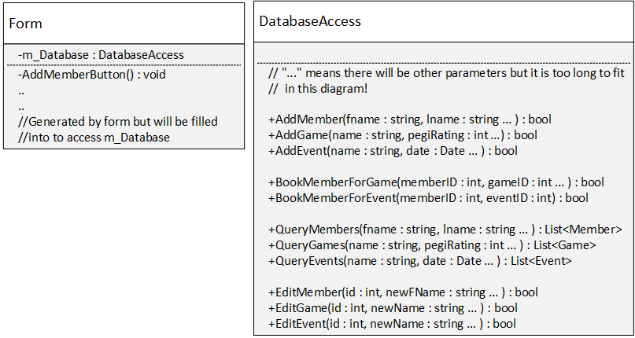
How did it aid development?
Helped create the class diagram.
Responsibilities helped to understand their purpose better.
Collaborations helped to understand their interactions better.

Slide 6
Why were they used?
Easy to create due to simple design.
Convey more info and easily understandable.
Implement classes into the software easily.

Slide 7
references
AMBLER S., n.d. Class Responsibility Collaborator (CRC) Models: An Agile Introduction [viewed 11 April 2018]. Available from: http://www.agilemodeling.com/artifacts/crcModel.htm

